Slide 1
Trivadis Technology Radar
Guido Schmutz
@gschmutz
http://guidoschmutz@wordpress.com

Slide 2
What is a Technology Radar?
Each of the items is classified in one of these rings:
Adopt: We can clearly recommend this technology. We have used it for longer period of time in many teams and it has proven to be stable and useful.
Trial: We have used it with success and recommend to have a closer look at the technology in this ring. The goal of items here is to look at them more closely, with the goal to bring them to the adopt level.
Assess: We have tried it out and we find it promising. We recommend having a look at these items when you face a specific need for the technology in your project.
Hold: This category is a bit special. Unlike the others, we recommend to stop doing or using something. That does not mean that there are bad and it often might be ok to use them in existing projects. But we move things here if we think we shouldn't do them anymore - because we see better options or alternatives now.

Slide 3
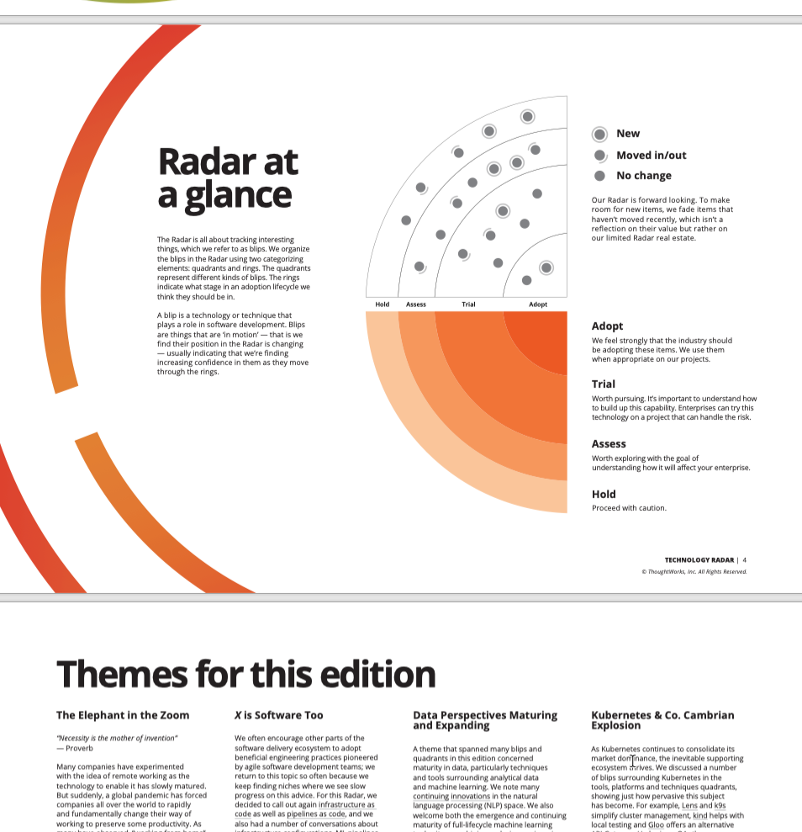
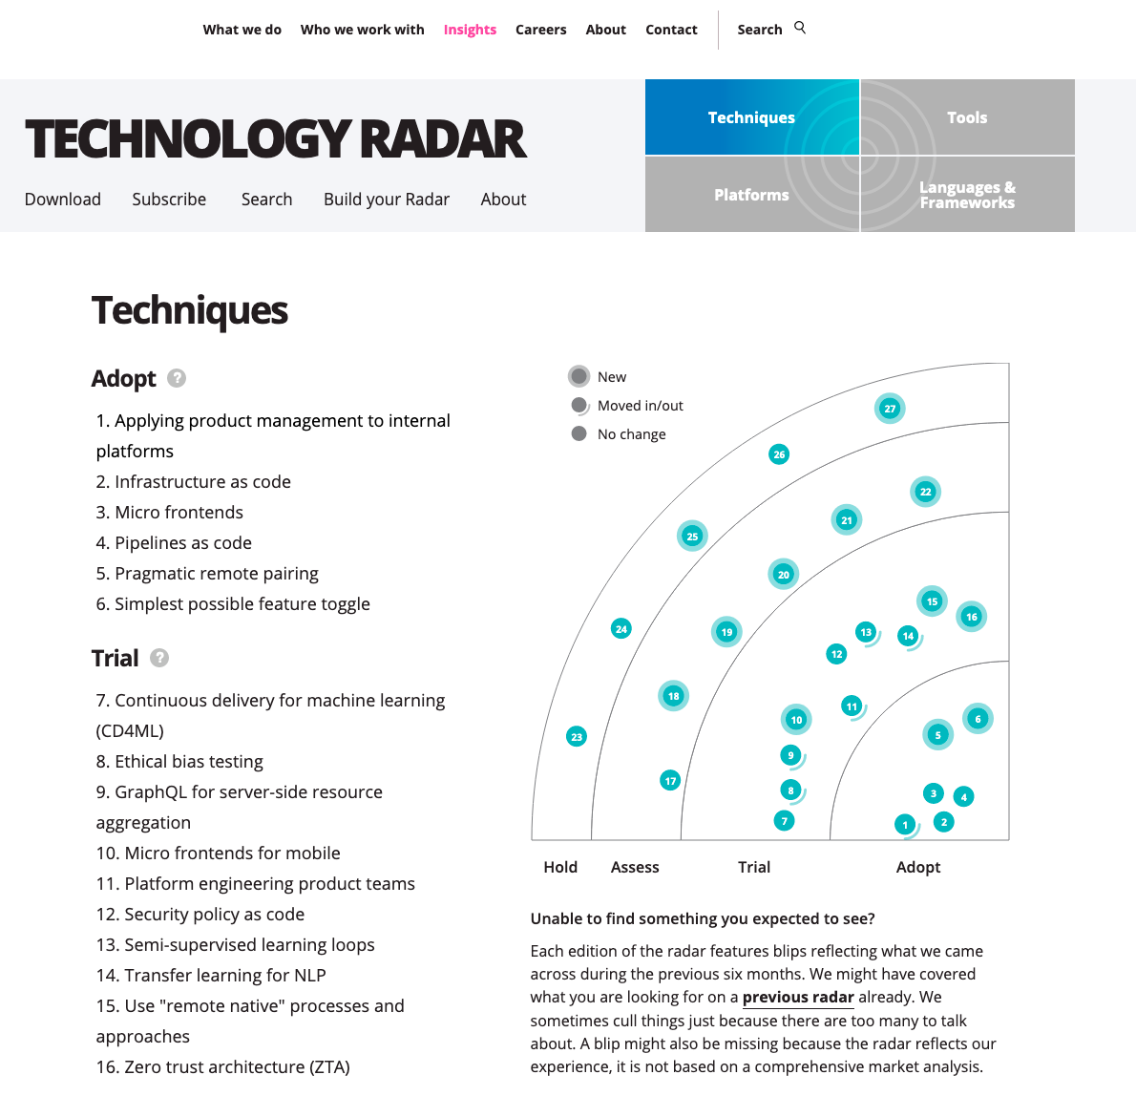
Thought Works https://www.thoughtworks.com/radar

Slide 4
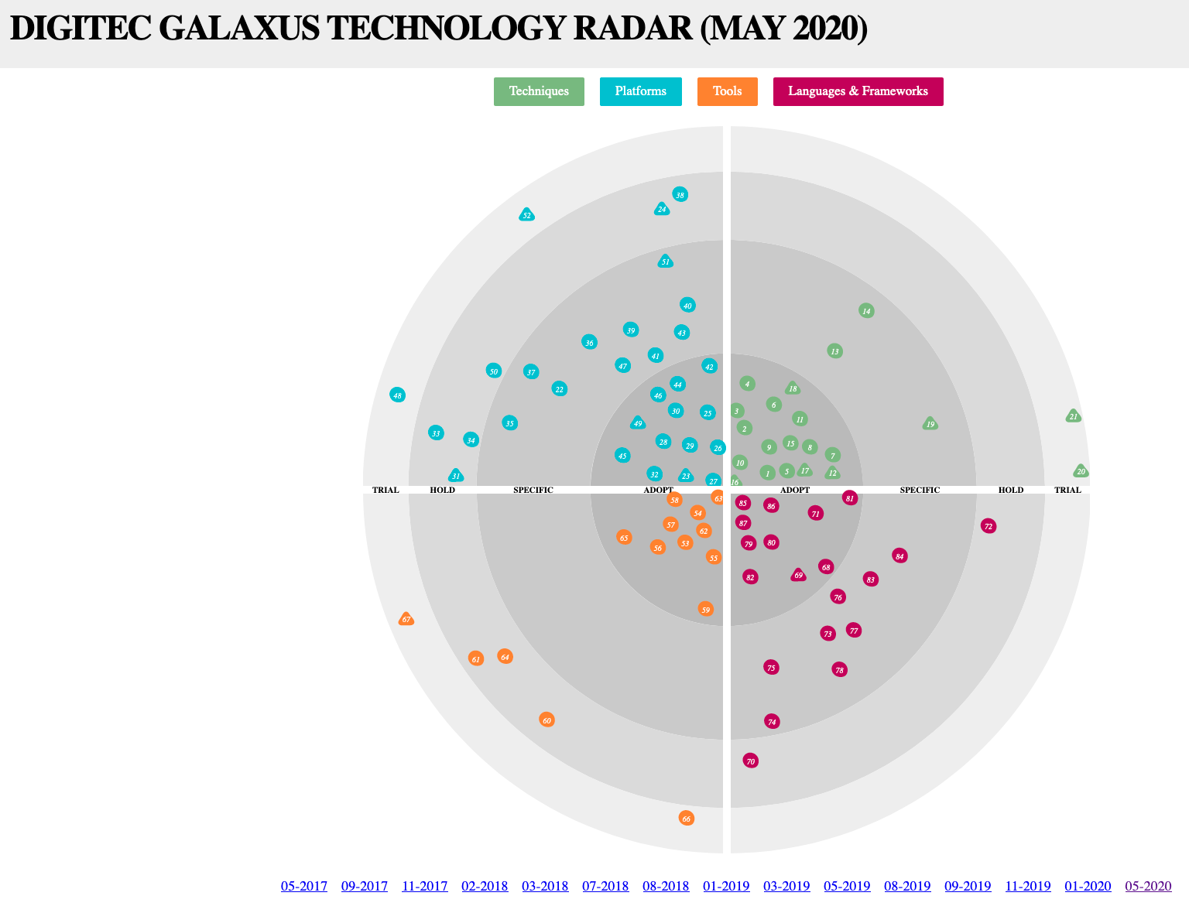
Digitec / Galaxus https://www.galaxus.ch/techradar/

Slide 5
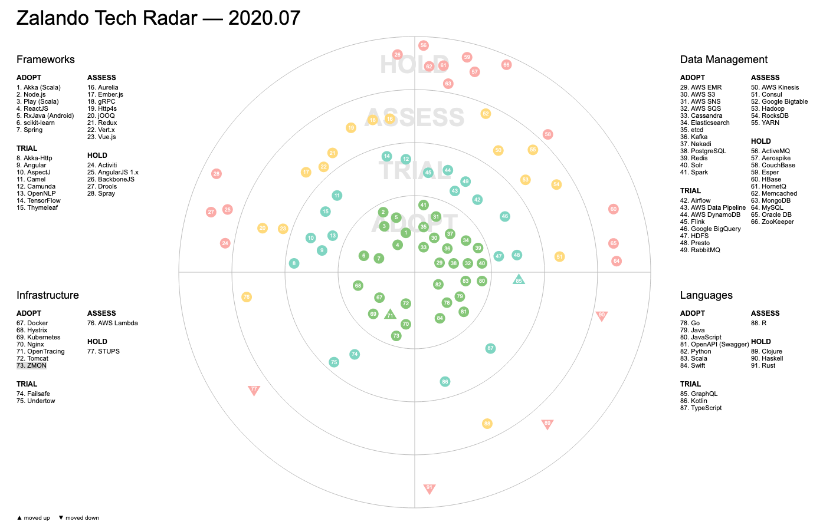
Zalando https://opensource.zalando.com/tech-radar/

Slide 6
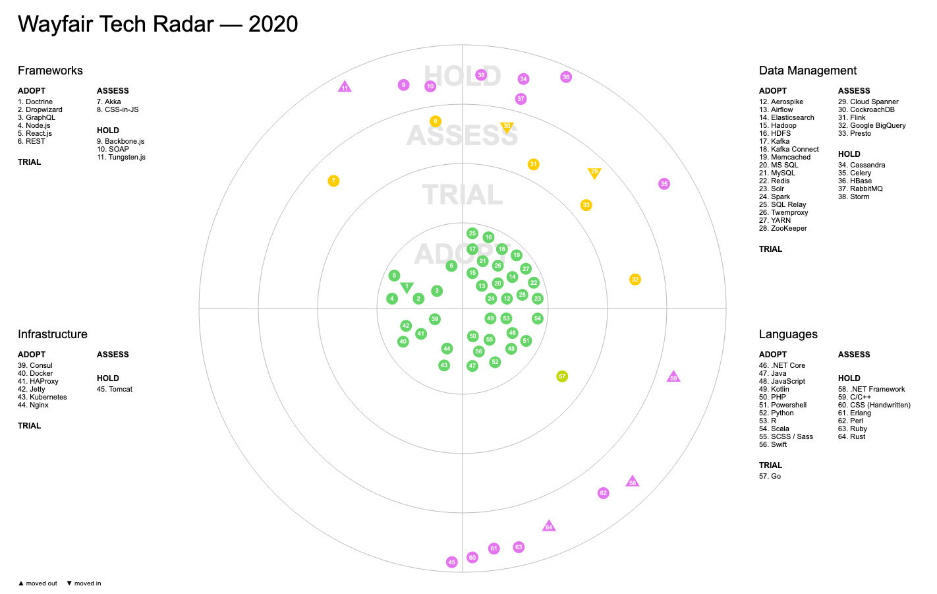
Wayfair https://storage.googleapis.com/wf-techradar-prod/index.html

Slide 7
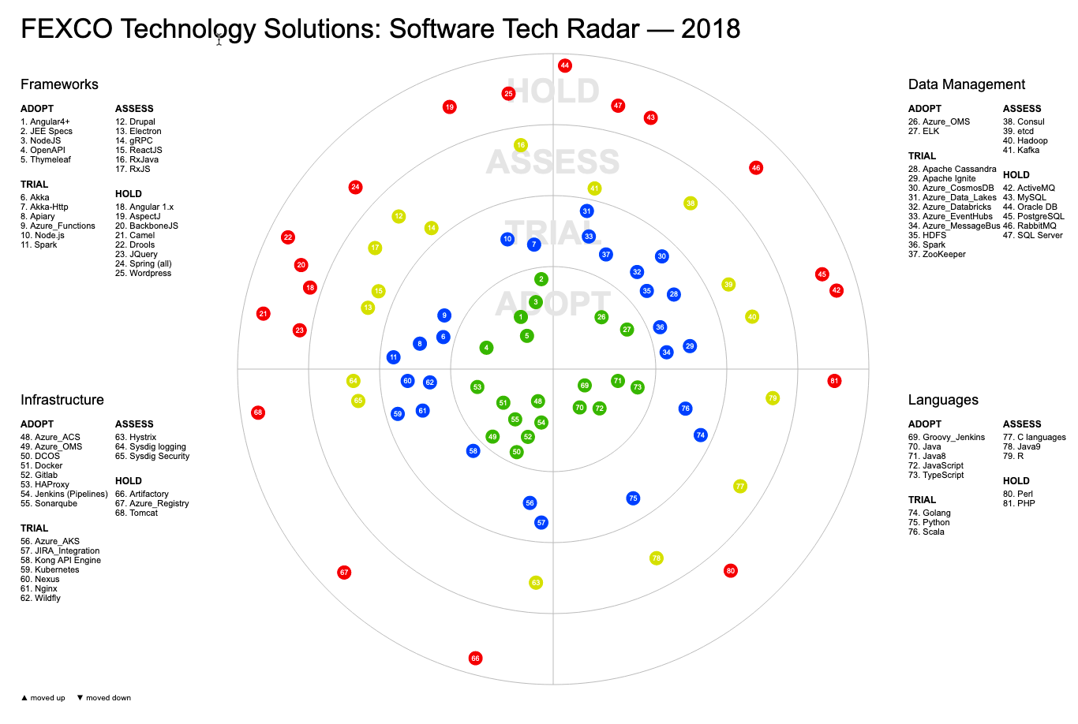
FEXCO Tech Radar https://techblog.fexcofts.com/techradar2018Q1//

Slide 8
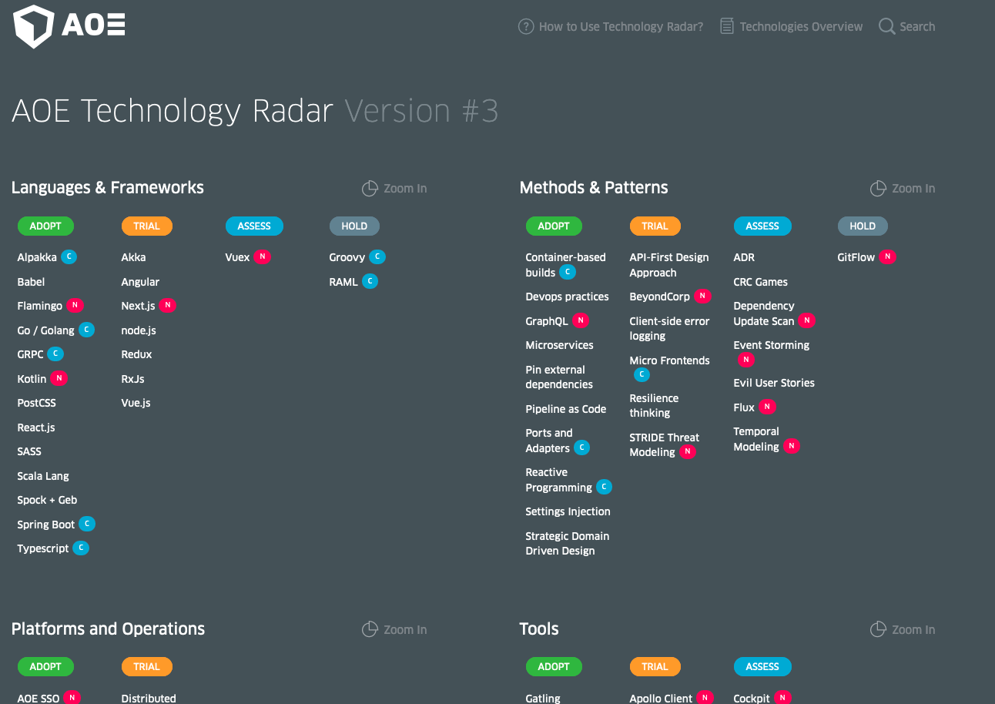
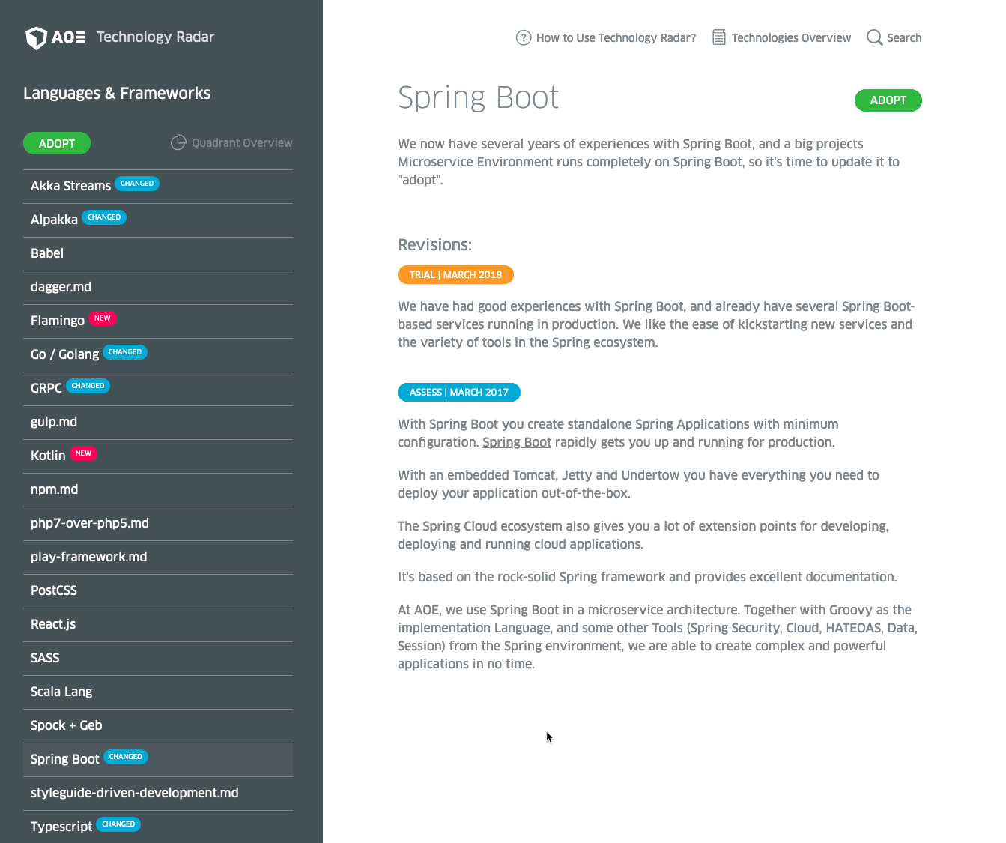
AOE Technology Radar https://www.aoe.com/techradar/index.html

Slide 9
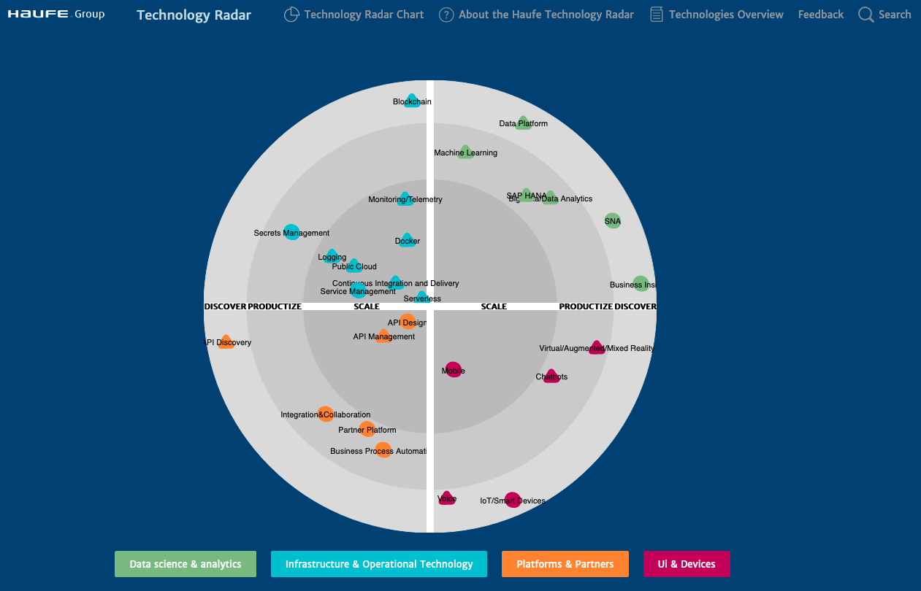
Haufe https://techradar.haufe.io/techradar/radar-chart.html

Slide 10
Trivadis Technology Radar

Slide 11
Trivadis Quadrants
Languages & Frameworks
Data Management
Platform & Services
Architecture, Methods & Patterns

Slide 12










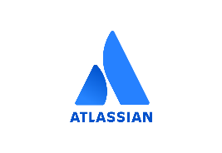
















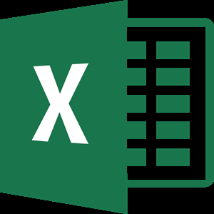
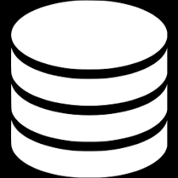


Solution Framework v4-2020-03-17
Product based (Low Code)
Apex
DevOps
Azure DevOps
LogicApps
Platforms / Operation
☁ - Cloud Platforms
Analysis / AI
«R»
Angular
Python
JavaScript
- Cloud Platforms
Code / Compute
NGRX
TypeScript
Processing / Storage
Power BI
Visualization / Interaction

Slide 13
















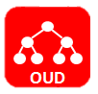












Technology Stack Data Platforms
Storage
Processing
Cloud Computing
Container & (Development) Automation
Security
Notes:
English version

Slide 14


